Slide 1
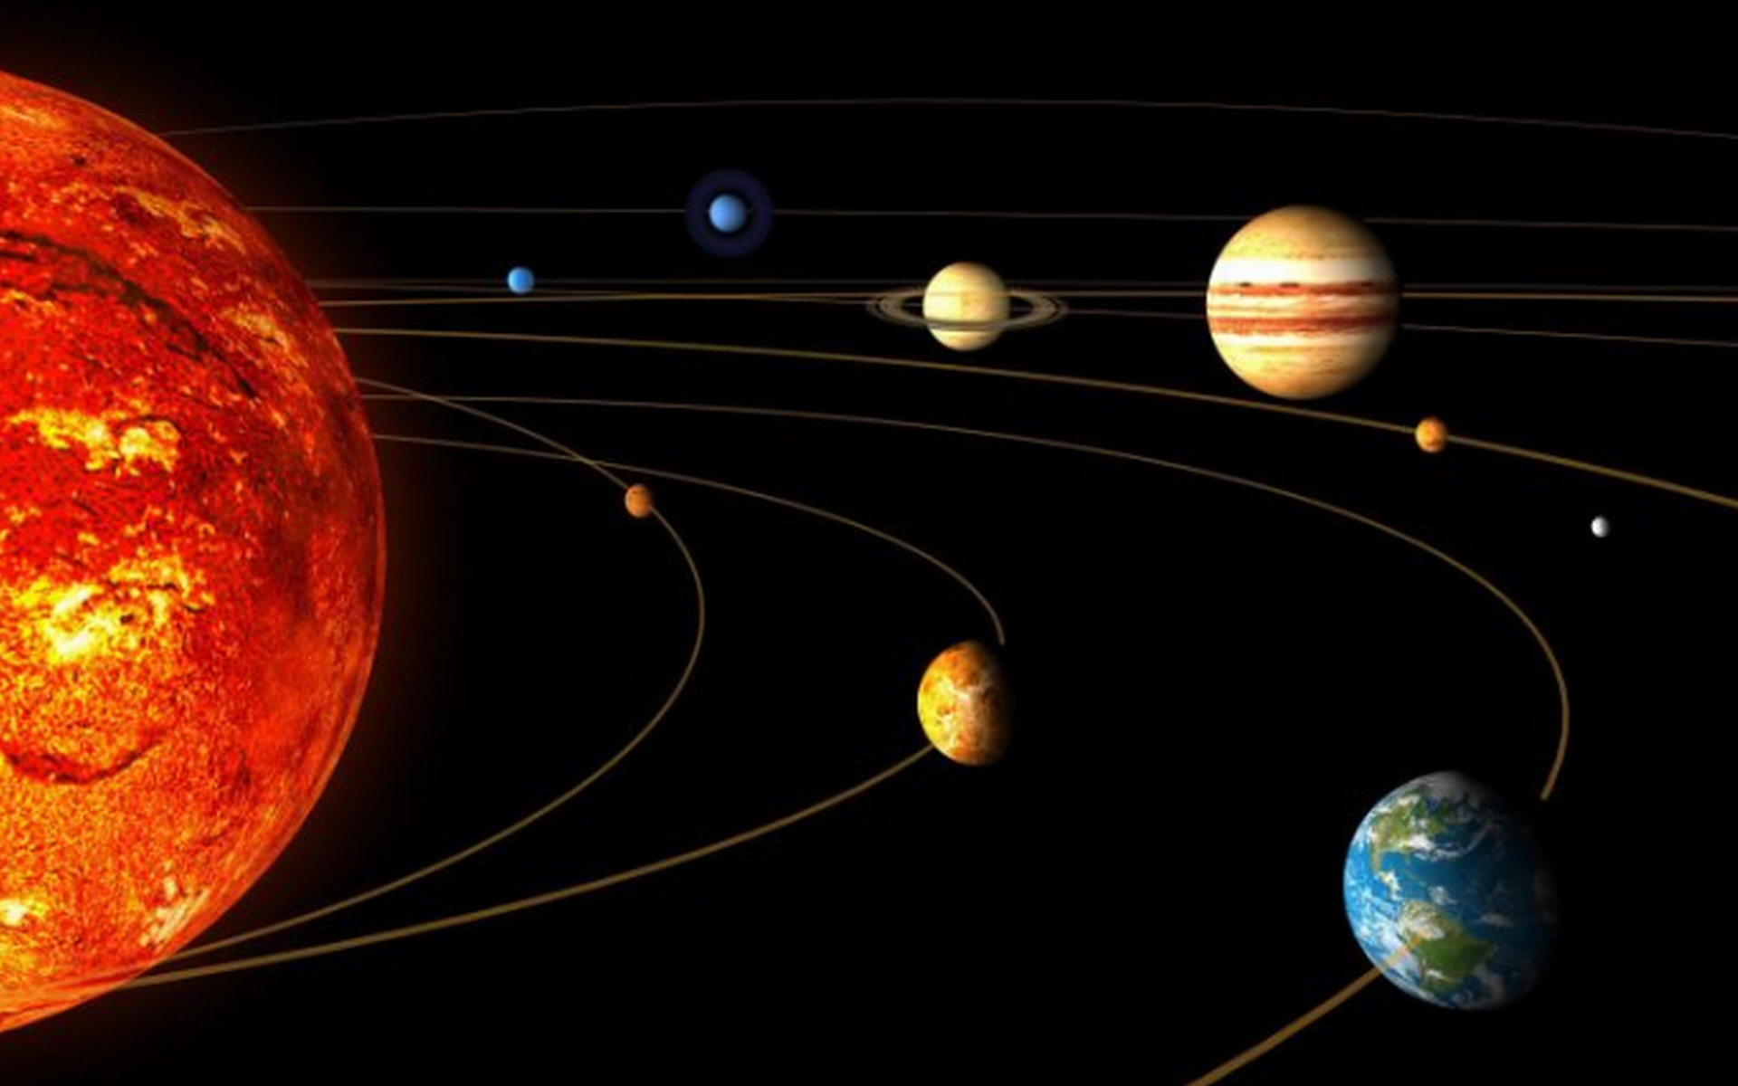
SOME GENERAL CONCEPTS IN GEOLOGY
Prepared by
Najma ul nisha
Lecturer(AA)
Department of Geology
Govt. PG Degree College, Rajouri

Slide 2
About Geology and its place in Earth Sciences
Etymology: gê(Greek): Earth ; logia(Greek): study of
It is the science that deals with the dynamics and physical history of the Earth, the rocks of which it is composed, and the physical, chemical and biological changes that the earth has undergone or is undergoing.
It comes under the umbrella of Earth Sciences with many other subjects at times overlapping and at times canvassing various others allied subjects and offshoots which include Geography, Meteorology, Oceanography, Geomorphology, Planetary Sciences, Remote Sensing etc, Structural Geology, Geophysics, Geochemistry, Palaeontology, Micropalaeontology, Hydrology, Mineralogy, Petroleum Geology, Coal Geology, Mining Geology, Petrology, Palynology etc.

Slide 3
Geology(भूविज्ञान/ارضیات) versus Geography(भूगोल/جغرافیہ)
Geology is a science that is interested in how the land got into the shape it did. It is mostly about what the ground is made up of from a natural perspective. What kind of rocks it contains and how those rocks or layers of rocks got there.
Geography is mostly dealing with mapping the extent of landforms, how far rivers are, how long mountain ranges are, how long the coast line is. This is often from the perspective of people or culture.
The ending of the word (suffix) also is an indication of the differences between geography and geology. _graphy means to draw or record. In other words, 'to draw the land' and _ology meaning 'to find knowledge or to study'

Slide 4
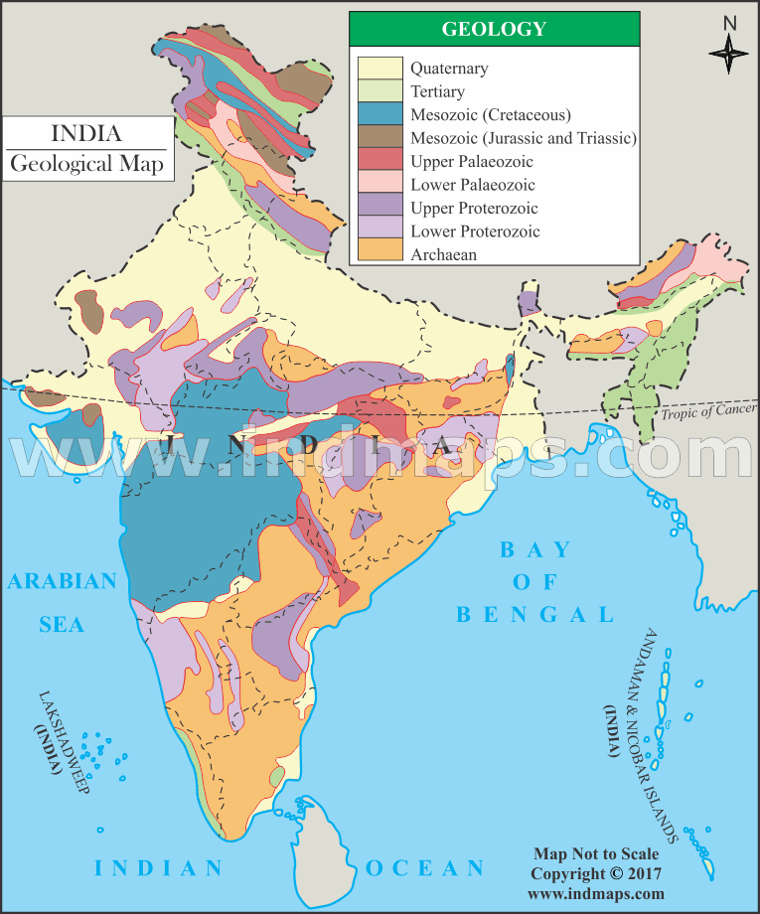
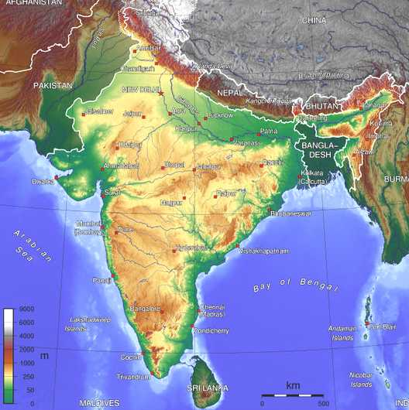
Simplified Geological Map of India
Simplified Geographic Map of India

Slide 5
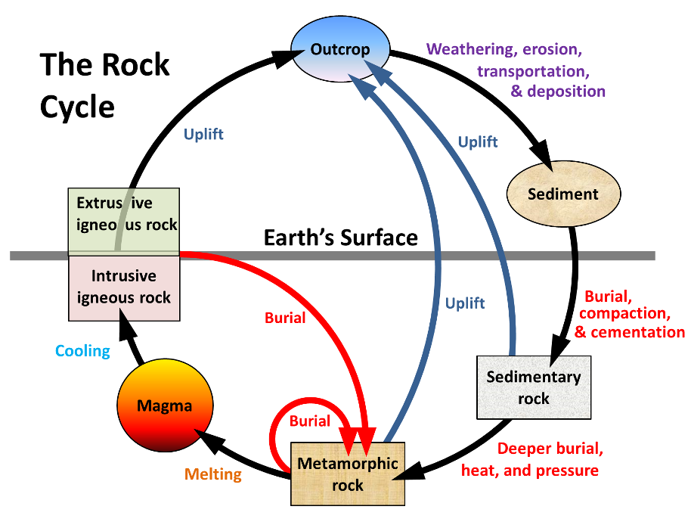
Rock Cycle
Rock Cycle:
Igneous Rocks,
Sedimentary Rocks,
Metamorphic Rocks.
Weathering vs. Erosion.

Slide 6
Minerals: Constituents of Rocks.
Minerals can be defined as a homogeneous, naturally occurring, solid substance having definable chemical composition and characterized by an orderly arrangement of atoms into a crystalline structure. Minerals are generally inorganic.
Homogeneous…
Naturally Occurring…
Solid Substance…
Definable Chemical Composition…
Orderly Arrangement of Atoms…
Inorganic…
THE CURIOUS CASE OF COAL & DIAMOND
Geologists term it as a Sedimentary Rock. A more acceptable term is MINERALOID

Slide 7
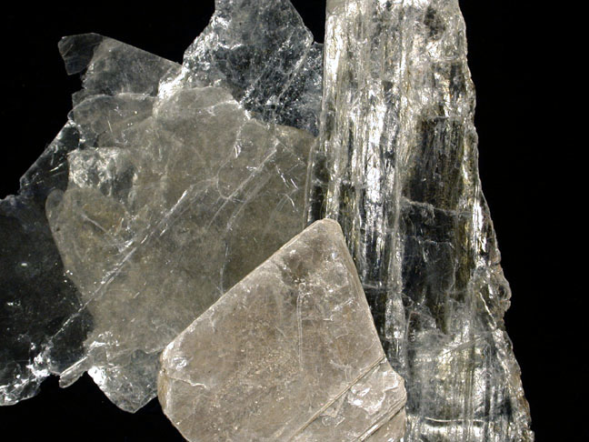
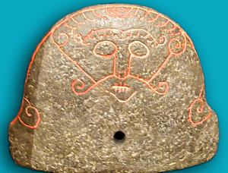
Minerals(Continued…)
There are more than 4000 minerals identified on Earth and list continues to grown with fresh additions every year.
Minerals can be a bone of contention in a war: Strategic Minerals
Some interesting etymologies.
Muscovite: Muscovy Glass, related to Moscow
Illite: gets its name from the first recognition in Illinois, USA.
Albite: Latin for White
Sillimanite named after scientist Benjamin Silliman.
Orthoclase: German to split at right angles
Talc : from Talcum- a cosmetic preparation which uses mineral Talc in it.
This soapstone*artifact(on the right) was found in Denmark and is interpreted
as a bellows shield with a depiction of Loki with his lips sewn shut, the result
of his loosing his wager with the dwarf smiths Brokkr and Sindri,
told in the myths. The stone is about 20cm across, with a hole near the base presumably to allow air from the bellows to reach the fire.
*Soapstone is a metamorphic rock rich in Talc with other minerals such as Chlorite, Muscovite etc.
Muscovite(source:www.pitt.edu)
Soapstone Artifact of Viking Age c. 793-1066 ACE

Slide 8
Mineral Physical Properties:
Color
Streak
Luster
Habit
Form
Cleavage
Fracture
Hardness
Specific Gravity

Slide 9
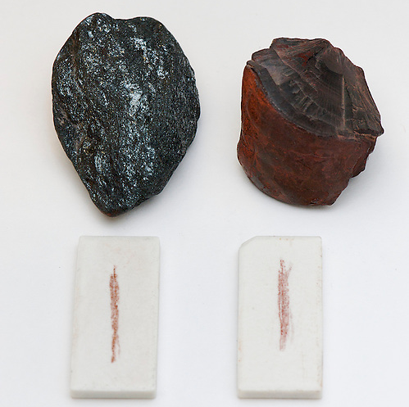
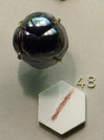
Physical Properties of Minerals: Colour & Streak
How does Human eye perceives colours?
COLOUR is a resultant of interaction of light rays with the minerals, with the wavelengths of light that are not absorbed are sent back and its resultant wavelength is perceived by the eye as colour.
STREAK is the colour of the powder of the mineral , obtained by rubbing the mineral on a streak plate that is an unglazed porcelain plate(Hardness 6.5 to 7) of white or black colour(used specifically for minerals that give a pale or white streak).
Streak many times is lighter than the original colour of the mineral & many a times is completely different from the perceived colour of the mineral
Heamatite can be black, red, brown, or silver in color and occur in a wide variety of forms but all specimens of hematite produce a streak with a reddish color. This is a valuable test for hematite. It can be used to differentiate hematite from a large number of other opaque minerals with a high specific gravity and similar color and habit.
Specimen showing Red colour streak of Heamatite along with its various forms.

Slide 10
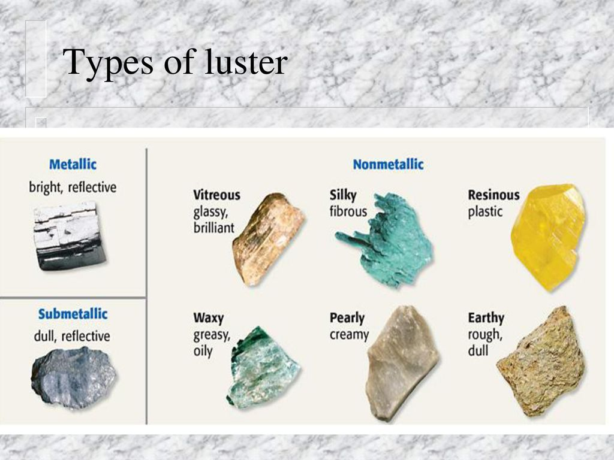
Physical Properties of Minerals: LUSTER
Its Luster or Lustre and not LUSTURE.
Etymology: lux(Latin), meaning "light",
Lustre is the way light interacts with the surface of a crystal, rock, or mineral.
It generally implies radiance, gloss, or brilliance

Slide 11
Physical Properties of Minerals: HABIT
The development of an individual crystal or an aggregate of crystals to produce a produce a particular external shape.
It heavily depends on the conditions during formation.
One such environment may produce long needle like crystals(acicular), while other may produce short Platy crystals .
Its quite possible to have a same mineral assume two or more than two habits
Examples include
Bladed habit of Kyanite
Acicular habit of Tourmaline
Amygdaloidal habit common in zeolites and of minerals in lava flows
Botryoidal habit, grape shape habit common in Haematite

Slide 12
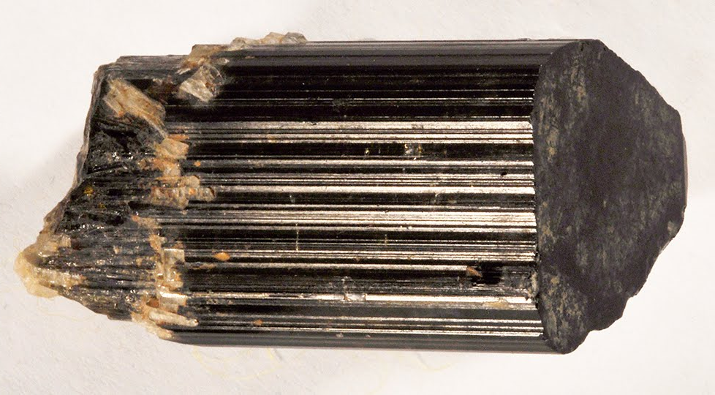
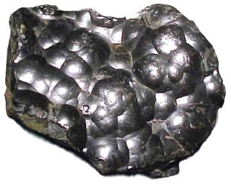
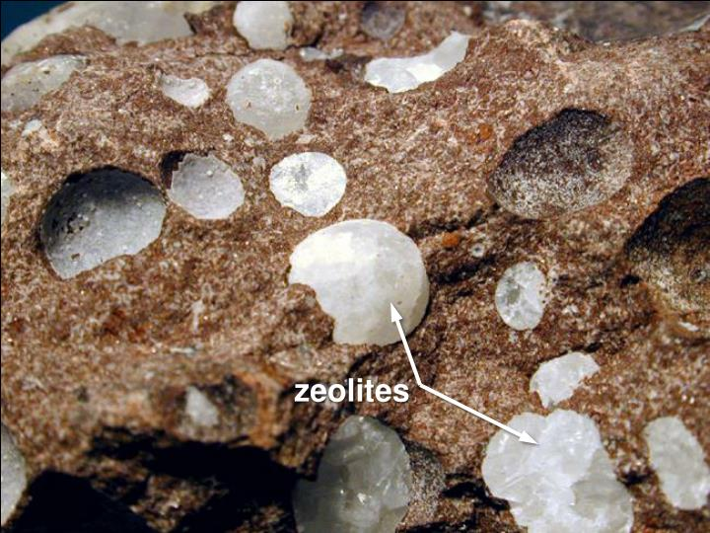
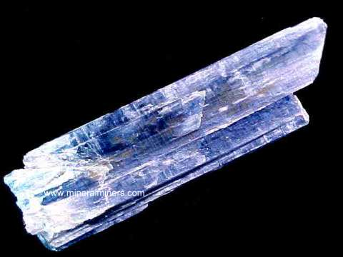
Haematite showing Botryoidal habit
Tourmaline showing Acicular habit
Zeolites in Basalts showing Amygdaloidal habit
Kyanite showing Bladed habit

Slide 13
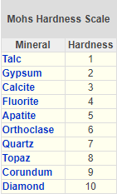
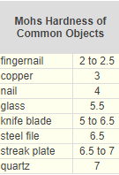
Physical Properties of Minerals: HARDNESS
It is an important physical properties that tells about the robustness of the mineral and it is these mineral grains which when will aggregate will impart hardness to the rock (although other things too play role in the hardness of the rock).
A common scale called Mohs Scale(not MOH’S) of Hardness, given by Friedrich Mohs, a German mineralogist, who developed the scale in 1812.
ABBERATIONS
Some minerals have not same hardness throughout like
Kyanite:These crystals have a hardness of about 5 if they
are tested parallel to the long axis of the crystal, and a
hardness of about 7 if they are tested parallel to the short
axis of a crystal.

Slide 14
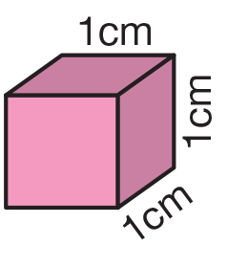
Physical Properties of Minerals: SPECIFIC GRAVITY
It is is the ratio of the density of a substance to the density of a reference substance of equal volume
OR
Ratio of the mass of the specimen to the mass of equal volume of water.
It is Ratio, so its is unitless and provides consistency worldover.
But WHAT it means?
Unit of volume is cm³. It implies a cube each of whose side is 1cm.
So when we say the specific gravity of Magnetite is 5.2, it implies that 1 cm³ of Magnetite is 5.2 times heavier than that of 1 cm³ of water

Slide 15
Thanks

